Slide 1

Getting Started with Flask: A Beginner's Guide
Welcome to the world of web development with Flask! This lightweight Python framework makes it easy to build websites and web services with just a few lines of code.
Feng-Cheng Lin

Slide 2





What is Flask?
Lightweight Framework
Flask is a micro web framework that provides essential functionalities with minimal setup.
Routing Capabilities
Easily map URLs to specific functions in your application.
Template Support
Create dynamic HTML pages using the built-in templating engine.
Authorization Features
Build secure applications with authentication and authorization.

Slide 3

Installing Flask
Verify installation
Install using pip
Import Flask in Python to ensure it's properly installed.
Check your environment
For local installations, use the command: pip install Flask
Flask is pre-installed in environments like Google Colab and Anaconda.
For Colab users, remember you'll need ngrok to access Flask apps. Anaconda Jupyter is recommended for beginners.

Slide 4





Importing Flask
Import the library
Create app object
Define routes
Run the app
from flask import Flask
app = Flask(__name__)
@app.route("/")
app.run()
The Flask import statement is your first step toward creating web applications. You can import the entire library or specific components as needed.

Slide 5
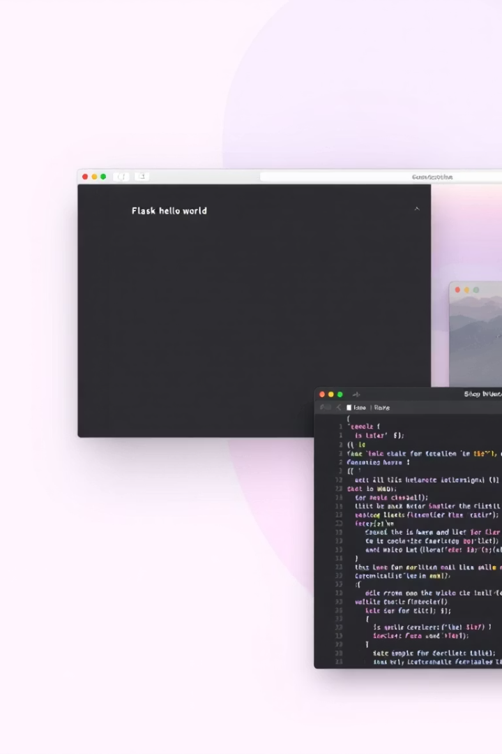
Creating Your First Web Page
from flask import Flask # Import Flask app = Flask(__name__) # Create app object @app.route("/") # Define route def home(): # Function for route return "hello world" app.run() # Run the app
This simple code creates a basic web service that displays "hello world" when you access the local server at 127.0.0.1:5000.

Slide 6
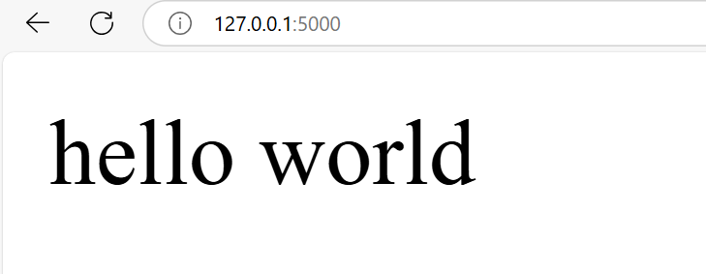
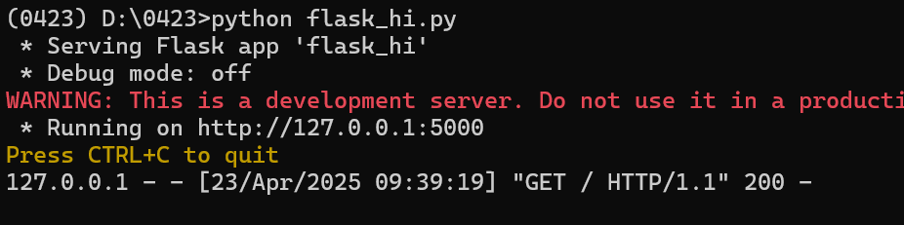
from flask import Flask # Import Flask
app = Flask(__name__) # Create app object
@app.route("/") # Define route
def home(): # Function for route
return "hello world"
app.run() # Run the app

Slide 7








Understanding Routes and Requests
Define the route
Create the function
Use @app.route("/") to specify which URL path triggers the function
Write a function that returns HTML content to be displayed
See the result
Access the URL
The browser displays the HTML returned by your function
Visit the specified URL to trigger the function

Slide 8
Setting GET and POST Methods
GET Method (Default)
POST Method
Used when requesting data from the server.
Used when sending data to the server.
Parameters are visible in the URL.
Parameters are hidden in message body.
@app.route("/")
def home():
return "GET request"
@app.route("/", methods=['POST'])
def home():
return "POST request"
Choose GET for retrieving data and POST for submitting data or when security is a concern.

Slide 9
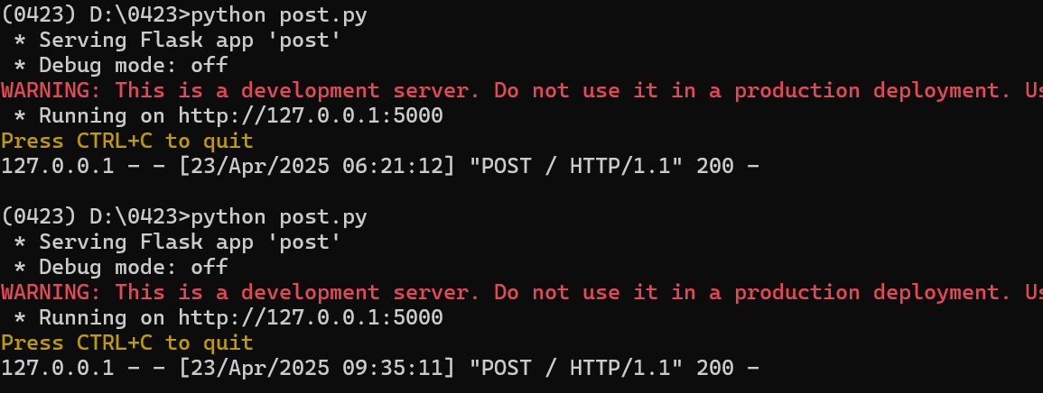
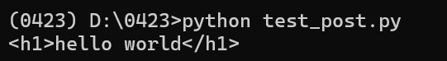
from flask import Flask
app = Flask(__name__)
@app.route("/", methods=['POST'])
def home():
return "<h1>hello world</h1>"
app.run()
import requests
web = requests.post('http://127.0.0.1:5000/') # Use post method
print(web.text) # read and print the attribute of text

Slide 10

Configuring Port Settings
Default Settings
Custom Port
Custom Host
By default, Flask runs on 127.0.0.1 (localhost) and port 5000.
Change the port with: app.run(port=5555)
Use your machine's IP with: app.run(host="0.0.0.0")
from flask import Flask app = Flask(__name__) @app.route("/") def home(): return "hello world" app.run(host="0.0.0.0", port=5555)

Slide 11



Using URL Variables
Basic variable
@app.route("/")
Type conversion
@app.route("/")
Path variable
@app.route("/")
URL variables make your routes dynamic. Access the variable value as a parameter in your function: def show_user(id): return f"User {id}"

Slide 12
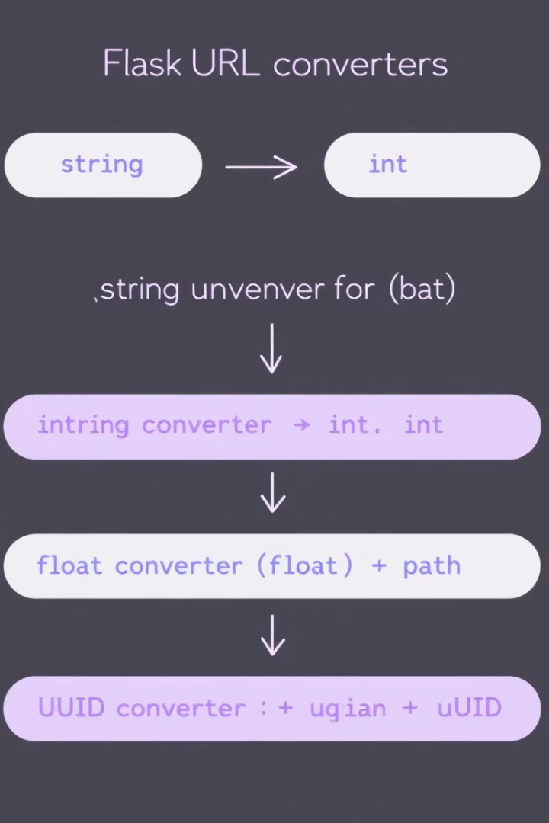
Type Converters for URL Variables
Type
Description
Example
string
Default. Text without slashes
/user/<string:name>
int
Positive integers
/post/<int:id>
float
Positive floating point
/rating/<float:score>
path
Text including slashes
/docs/<path:filename>
uuid
UUID strings
/user/<uuid:id>

Slide 13






Reading Request Parameters
Request object
Import with: from flask import request
GET parameters
Access with: request.args.get('param')
POST data
Access with: request.form.get('field')
The request object contains all data sent by the client. For URL parameters like "?name=John&age=25", use request.args.get('name') to get "John".

Slide 14
GET and POST Examples
GET Request Example
POST Request Example
@app.route('/')
def home():
name = request.args.get('name')
return f"Hello, {name}!"
# URL: example.com/?name=John
# Output: Hello, John!
@app.route('/', methods=['POST'])
def home():
name = request.form.get('name')
return f"Hello, {name}!"
# Form submission with name=John
# Output: Hello, John!
GET requests are good for search parameters and filters. POST requests are better for form submissions and sensitive data.
import requests
web = requests.post('http://127.0.0.1:5000/') # Use post method
print(web.text) # read and print the attribute of text
Notes:
https://steam.oxxostudio.tw/category/python/example/flask.html

Slide 15





Using HTML Templates
Create a templates folder
Make a 'templates' directory in your project root
Create HTML template files
Add HTML files with Jinja2 placeholders like {{ name }}
Import render_template
from flask import render_template
Render with variables
return render_template('index.html', name=username)

Slide 16

Jinja2 Template Syntax
1
Variables
Use double curly braces: {{ variable }}
2
Conditionals
{% if condition %} content {% endif %}
3
Loops
{% for item in items %} {{ item }} {% endfor %}
4
Template inheritance
{% extends "base.html" %} {% block content %}{% endblock %}
<!-- Example template file: hello.html --> <html> <body> {% if name %} <h1>Hello, {{ name }}!</h1> {% else %} <h1>Hello, World!</h1> {% endif %} </body> </html>

Slide 17
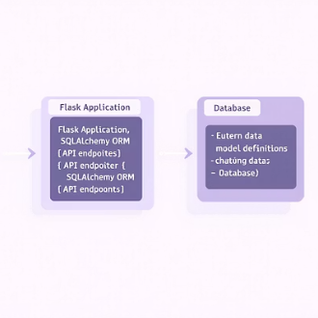
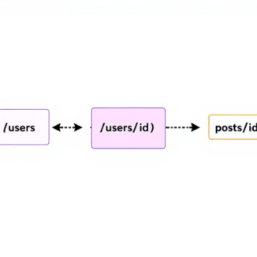
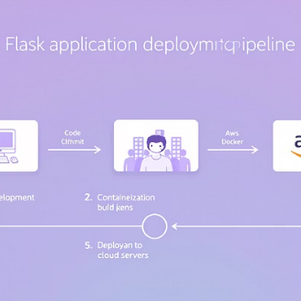
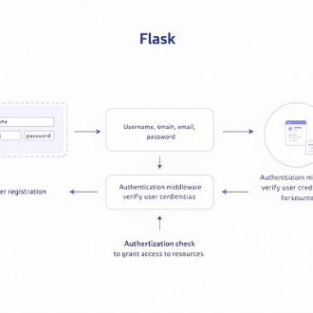

Next Steps in Your Flask Journey
Now that you've mastered the basics, explore advanced topics like database integration with SQLAlchemy, RESTful API development, deployment strategies, authentication systems, and frontend integration.

